Slide 1
The OAKSim Proposal
Group One

Slide 2


Goals
Provide a modern replacement of CSUN’s usage of “ARMSim”.
A modern, multiplatform tool for education of embedded environments.

Slide 3
Wants
Multiplatform - ARMSim# is only available for the Windows environment. Students on non-windows machines have had to install virtual machines and side-loaded operating systems just to get ARMSim# running.
Multi-architecture - Provide not just the ARM architecture, but x86,Mips, and so on.
Detailed diagnostic and error reporting - As an educational tool, the assembler will provide deep insight on errors of the assembly and run-time errors.
Debugging - Run-time debugging to provide deep insight on the inner workings of an assembly program.

Slide 4
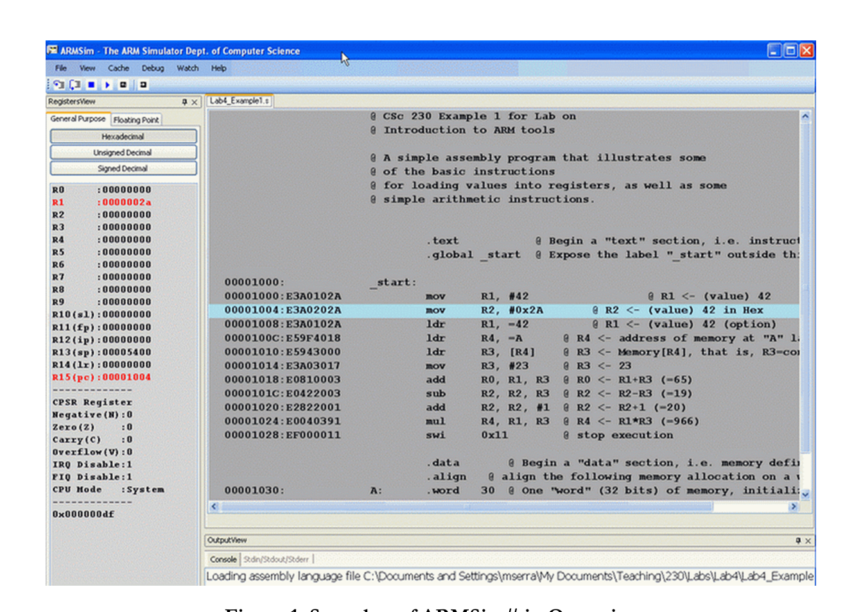

Don’t Wants

Slide 5



System Architecture(C++)
Keystone Engine
Open source libraries that assemble, simulate, and disassemble ARM,x86,etc
Pure C(Works very nice with C++)
Qt for GUI
Very fast
Unicorn Engine

Slide 6

System Architecture(Java)
Keystone Engine
Keystone engine not available
Have to write our own assembler(Lexer,Parser, etc)
Unicorn Engine

Slide 7


System Architecture(JavaScript)
Libraries can be ported to Javascript VM code and run right in the browser at near-native speeds
Naturally multi-platform and provides a very easy means to a GUI(html,css)
Can run offline or hosted(entirely front-end)
~13MB worth of minified JavaScript

Slide 8
How it will work
User provides assembler source code(Intel,GAS,AT&T syntax)
Input assembled into target machine code
Full simulation and debugging environment
Deep architecture and embedded environment insight

Slide 9

Process
Minimally achieve what ARMSim# provides.
Surpass the ARMSim# feature set.
Introduce new and improved functionality for the new simulator(extended architectures such as x86, x86_64,MIPS,etc)
Extend environment(LED Lights, Screen, buttons, File IO)

Slide 10


Team Framework
SCRUM(4 Week Sprints)
Github for rapid branching, iteration, and collaborative coding
Discord for our main platform for communication.

Slide 11

Intended Schedule
1/23 - 2/5
Research and prototyping
2/6 - 3/19
Minimal assembler/debugger functionality
3/20 -4/16
Feature extensions and GUI
4/17 - 5/14
Quality assurance and feedback

